Slide 1

Visualizing Survey Results in Tableau
Alison Blaine ablaine@ncsu.edu
Hannah Rainey hlrainey@ncsu.edu

Slide 2
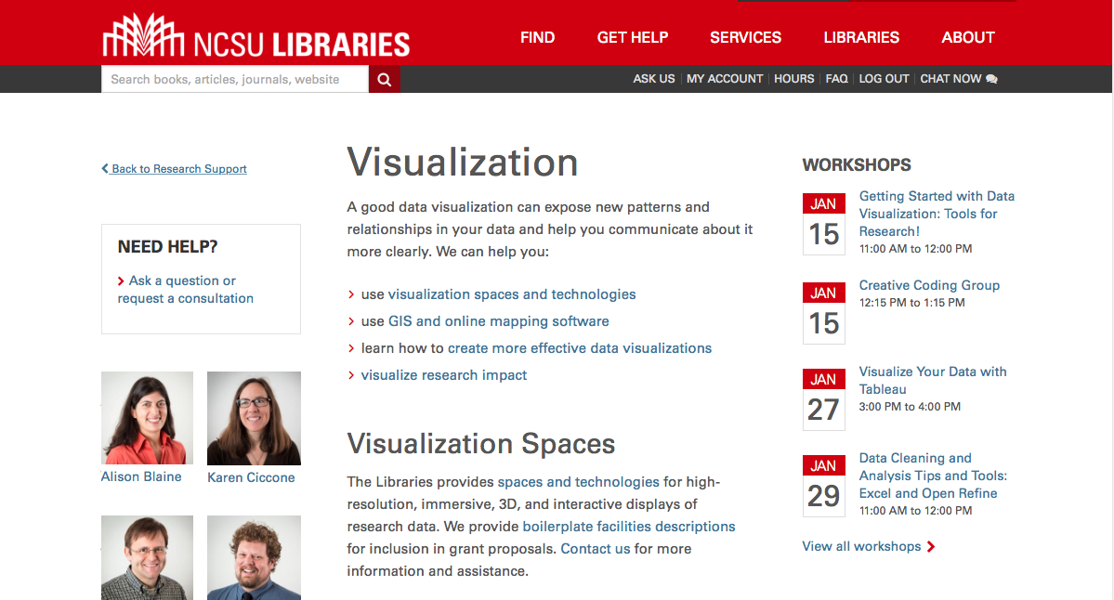
Data Visualization Services lib.ncsu.edu/do/visualization

Slide 3

Learning Objectives
Structure and process survey data for visualization
Create two visualizations from sample survey data using Tableau
We will not cover:
Survey design or methods

Slide 4
Resources
Data Revelations - Tableau Tips, by Steve Wexler
Visualizing Survey Data - Tableau White Paper
Notes:
These are the main resources we used to design this workshop. These are good resources to refer to in the future.

Slide 5

Download the dataset
go.ncsu.edu/surveyviz
SurveySampleData_July2014C.xlsx

Slide 6

Re-Shaping Survey Data for Visualization
a little preparation goes a long way

Slide 7
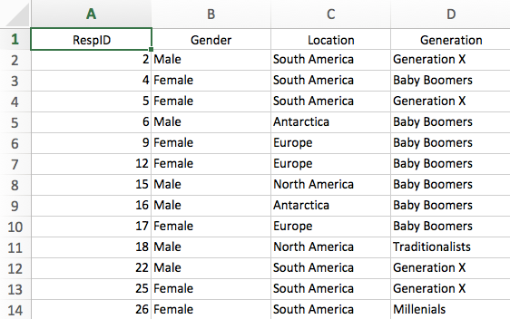
Demographic information
Notes:
Source: http://www.datarevelations.com/surveyjustso.html

Slide 8
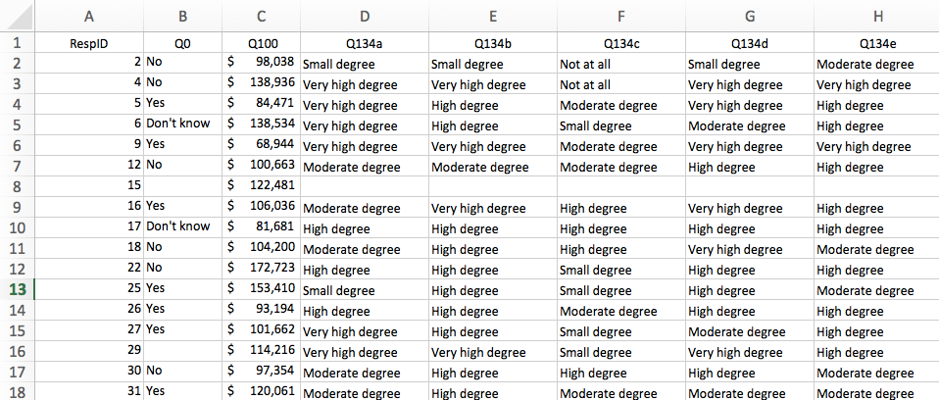
Text responses
Notes:
Many of the questions in this survey are Likert scale questions

Slide 9
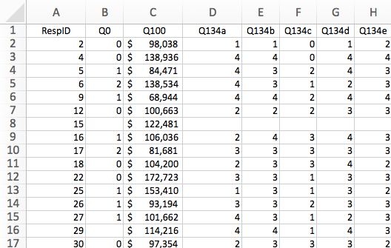
Number Responses

Slide 10
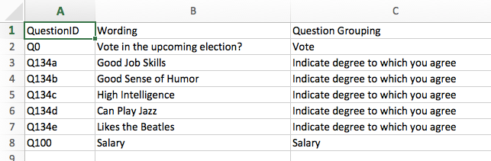
Metadata (Helper)

Slide 11
Data manipulation tips
For survey data, it is best practice to:
Give all questions unique IDs
Pivot your data so that all questions are in one column and all responses are in another.
The “Question ID” column has the question IDs
The “Response” column has participant responses.
However, if you have responses of different data types, consider having three columns:
“Question ID” “Text Response” and “Numeric Response” to be able to manipulate the data
Have “helper” columns that provide more information (metadata) about the questions

Slide 12
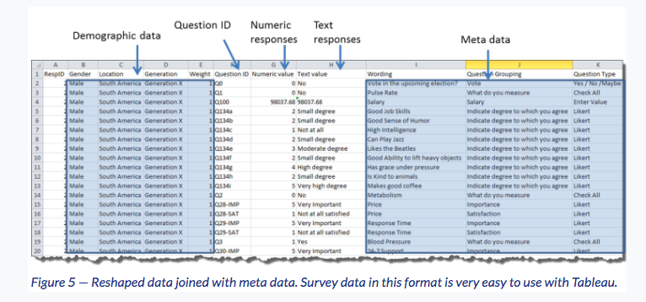
The ideal data table
Source: Steve Wexler, “Getting Survey Data Just So”

Slide 13
Data manipulation tips in Tableau
In Tableau, you can only make one pivot of your data.
If you want to do more custom pivoting, you can make data extracts (static subsets of your data).
Pivot these extracts of data how you like them and then join them together.
Making extracts is required to separate responses into 2 columns (Text Responses and Numeric Responses) - which would require two pivots
Notes:
Extracts are saved subsets of a data source that you can use to improve performance or to take advantage ofTableau functionality that is not available in the underlyingdata. When you extract your data to create an extract, you can reduce the total amount of data by defining filters and limits.

Slide 14
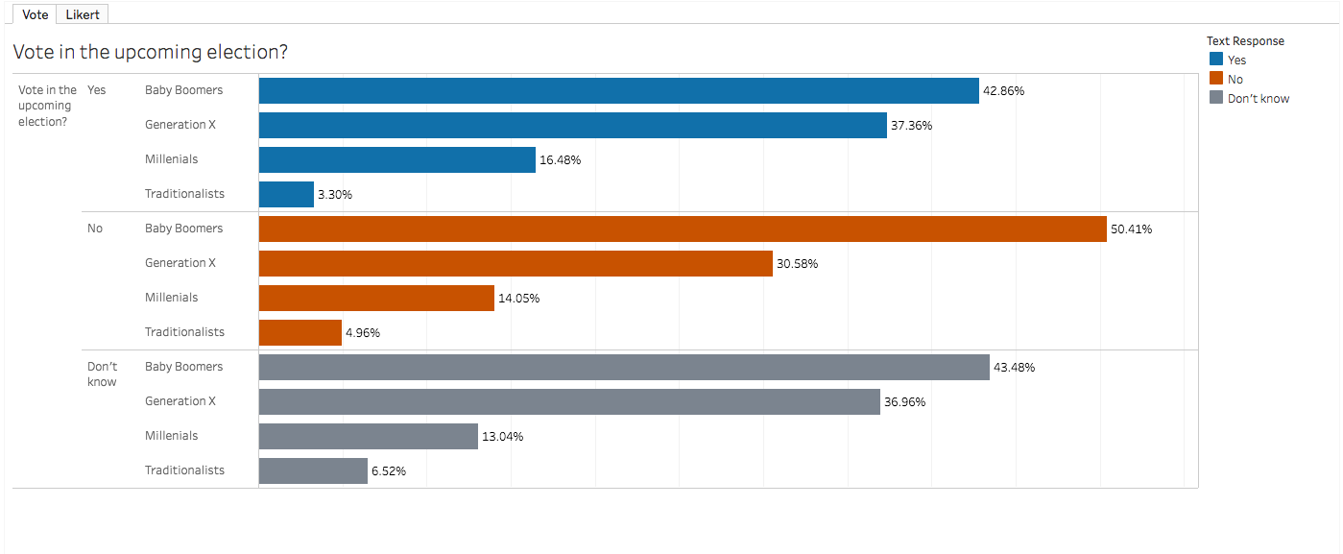
Activity : Yes, No, Maybe

Slide 15
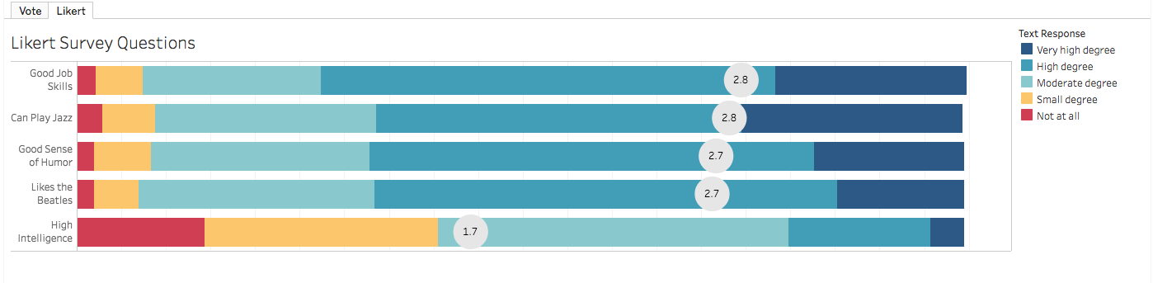
Activity: Likert scale

